Slide 1

Welkom bij

Slide 2
Wat gaan we doen deze week?
Formulieren
Oefening maken
Opdrachten maken
SmartPhone bestelpage voor smartphones4u maken

Slide 3
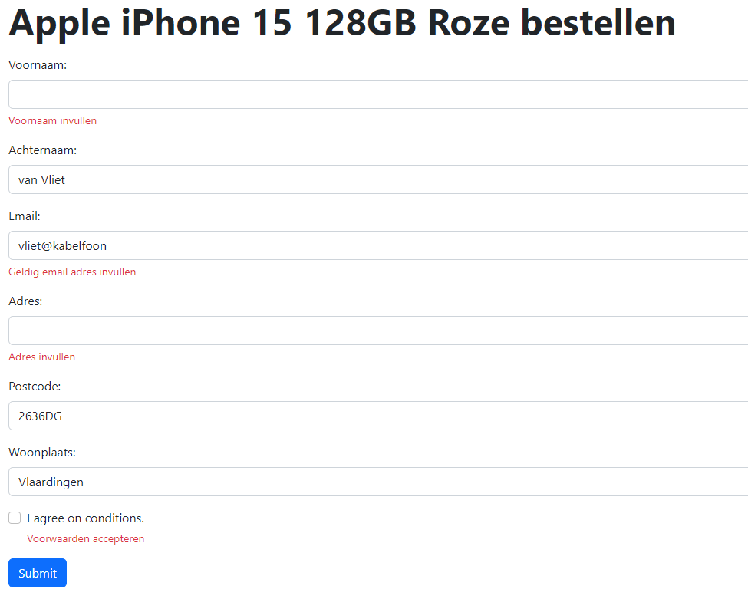
Formulieren deel 3

Slide 4
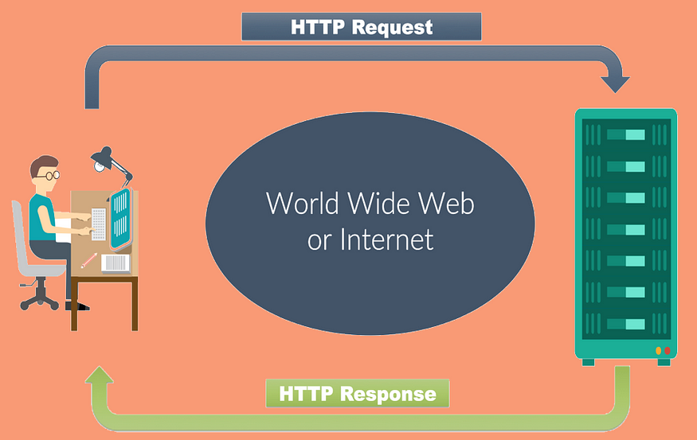
Client / server

Slide 5

HTTP-request
HTTP Method: This defines the action to be performed, such as GET (retrieve data), POST (send data), PUT (update data), DELETE (remove data), and more.
URI (Uniform Resource Identifier): It specifies the resource’s location or path on the server.
HTTP Version: It indicates the version of the HTTP protocol being used (e.g., HTTP/1.1).
Headers: Headers provide additional information about the request, such as the user-agent, content type, and authentication tokens.
Body: For some HTTP methods like POST and PUT, a request may include a message body containing data to be sent to the server.

Slide 6
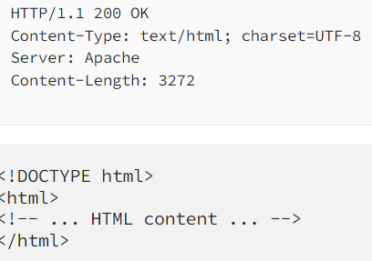
HTTP-response
Status Line: This line includes the HTTP version, a three-digit status code, and a brief textual description of the status.
Headers: Similar to request headers, response headers provide metadata about the response, such as content type, server type, and caching directives.
Body: The response body contains the requested data or resource. For HTML pages, this is the actual web page content. For images or files, it’s the binary data.

Slide 7
Formulier afhandeling bv order
Show FORM (showOrderForm.php)
FORM controller
(order.php)
REQUEST
order.php
Handle FORM (handelOrderForm.php)

Slide 8
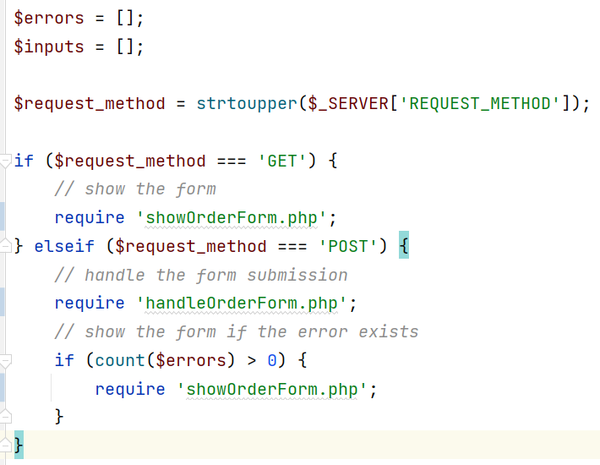
Formulier controller
FORM controller
(order.php)
GET
POST
showOrderForm.php
Errors?
handleOrderForm.php

Slide 9
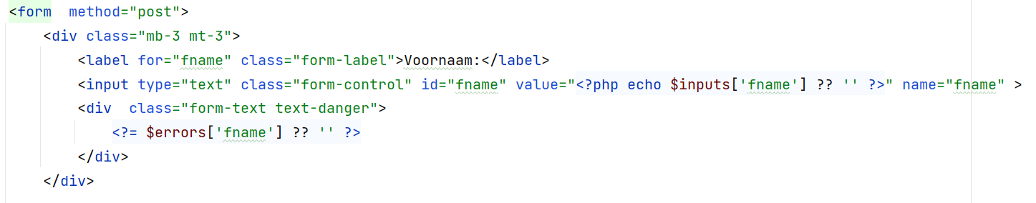
showOrderForm.php
De value attribuut toont de eventueel ingevoerde voornaam
De eventuele errors voor de voornaam worden getoond

Slide 10
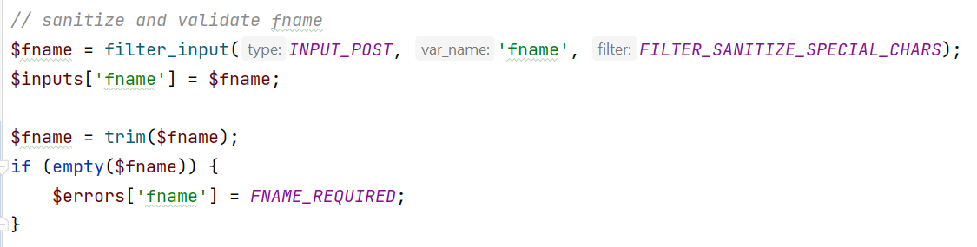
handleOrderForm.php
Zorg dat er voor < > en & html entities komen
Verwijder voorloop spaties voor controle of er iets ingevuld is

Slide 11
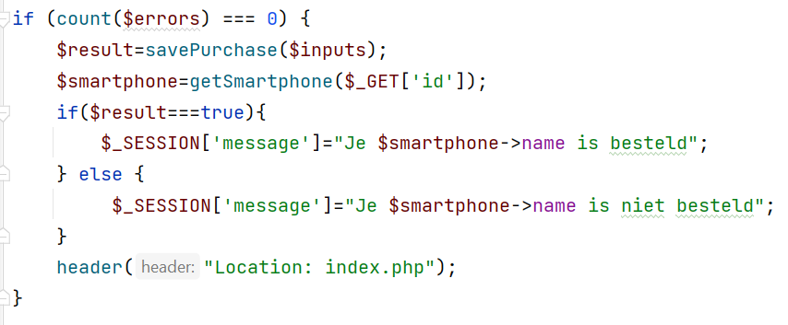
handleOrderForm.php
Aan het eind kijken of er geen errors zijn, dan geef je de inputs array mee aan de functie savePurchase
Geen errors, ga naar index.php KLAAR

